Slide 1


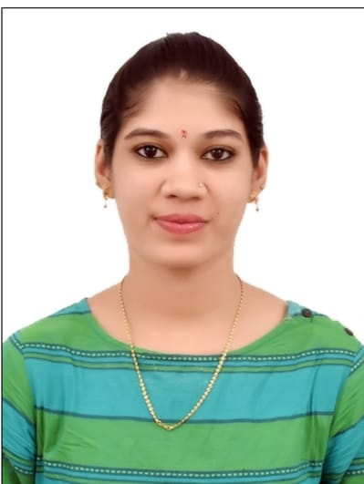
RedHat
PHOTO You Liked the Most :)
About Me :
Name : M Ankeeta
College : Godutai Engineering College for Women,Gulbarga
Github : https://github.com/m-ankeeta

Slide 2
My learning : W1
RedHat
Achievements : So, this week was full of achievements . I have learnt so many things this week. Deepak taught me about project management, user story, scrum,sprint etc..
Learning : As they learning has no limitations or end. This week I have learnt about new languages which once I wanted to learn about.Ankush sir has taught so much like user and root ,their commands in Linux. Same way Biswajeet sir has taught us about Python language with their codes and has also gave us a task to code the program from which we can succesfully learn how to write codes.

Slide 3
RedHat
GAS LEAKAGE CONTROLLER
SCQ: As I have learnt about SCQ is situation , challenge and question. So here is my
Situation: It is about gas leakages across the nation which make a disaster in the nation.
Challenge: It is how to prevent this using latest technologies.
Question: It is how it works?
Which technology to use?
User Stories :
As a developer, I want to develop a code in Arudino , so that I can prevent the blasts caused by it.
As a user, I want a technology , so that I can easily use and monitor

